Slide 1
WHO IS THE BEST?
By: Nebyu Bekele, Devan, Michael, Erick

Slide 2
TABLE OF CONTENTS
01
02
03
OVERVIEW
Data Analysis of statistical best offensive and defensive, and best overall team
FEATURES OF THIS TOPIC
Brief description of defense and offense
ASSIGNMENT
Data pulled from Kaggle, team stats & totals from 1947 - Present

Slide 3
BEST DEFENSIVE TEAM?

Slide 4
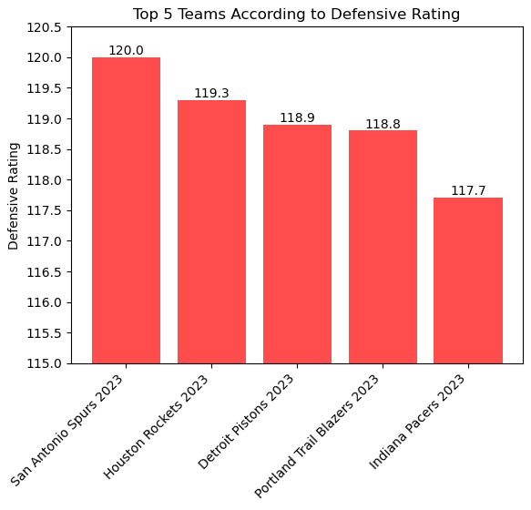
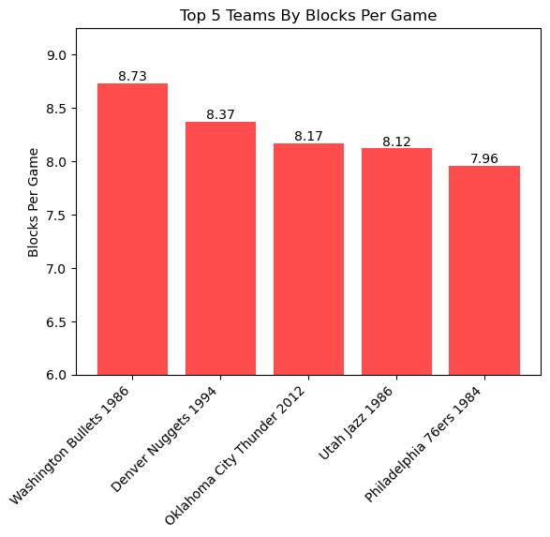
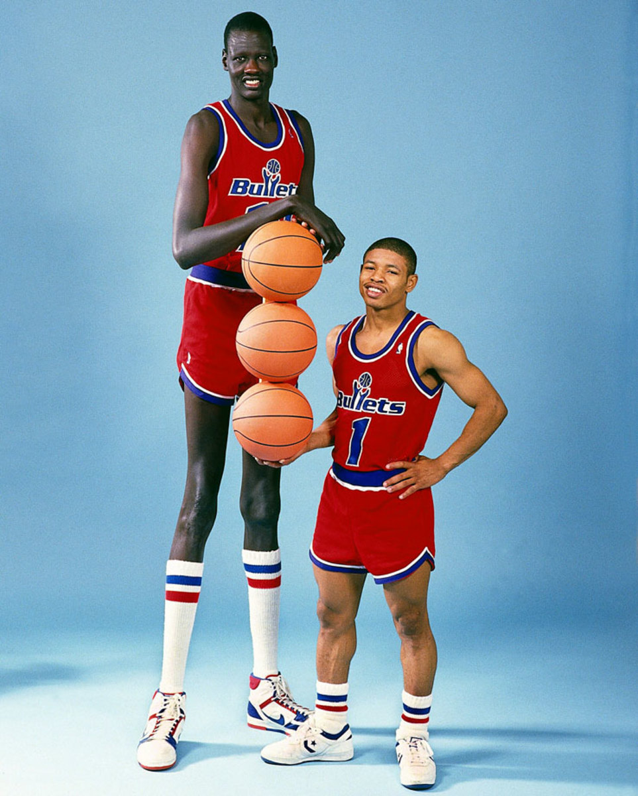
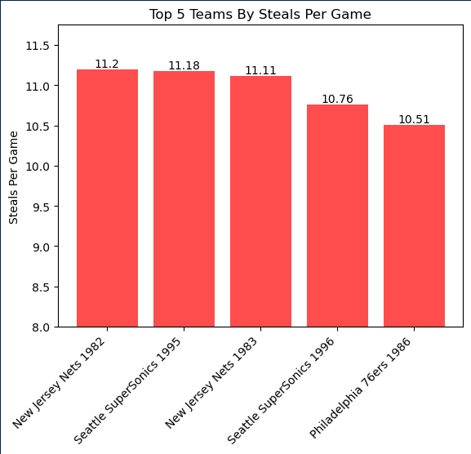
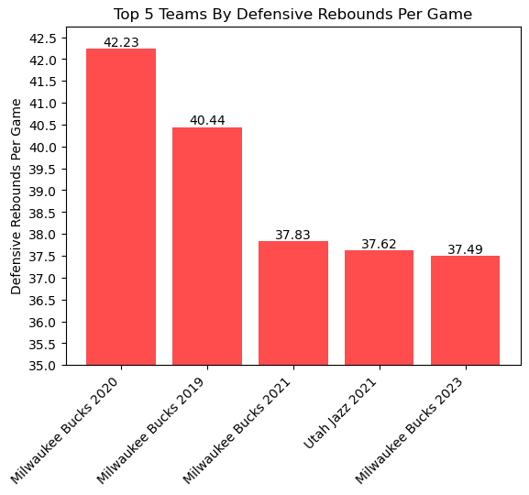
DEFENSIVE STATS

Slide 5

BEST OFFENSIVE TEAM?

Slide 6
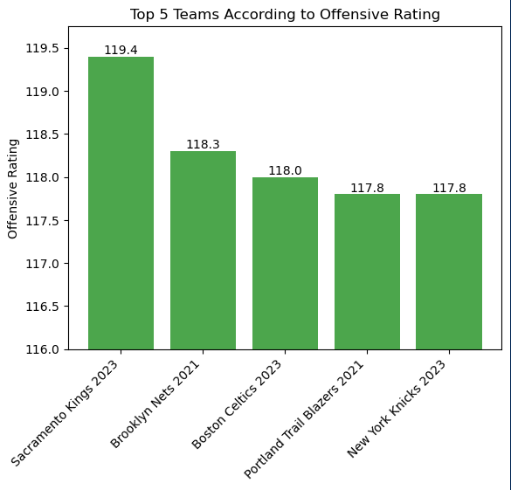
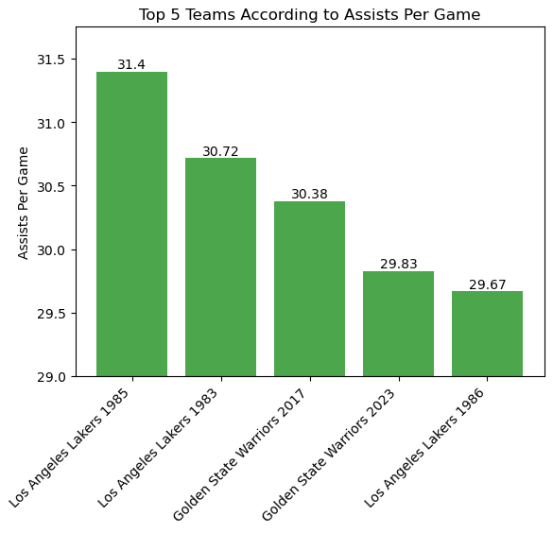
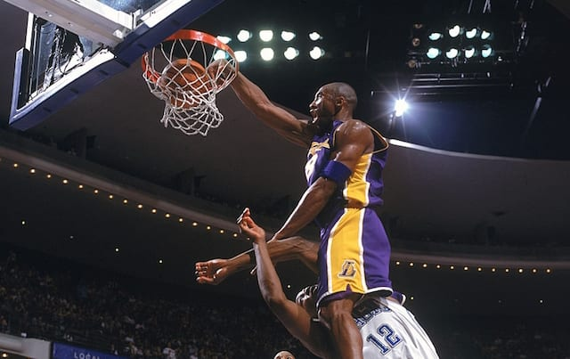
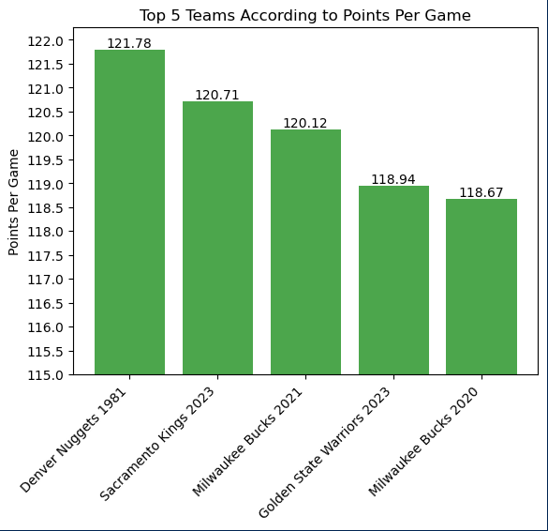
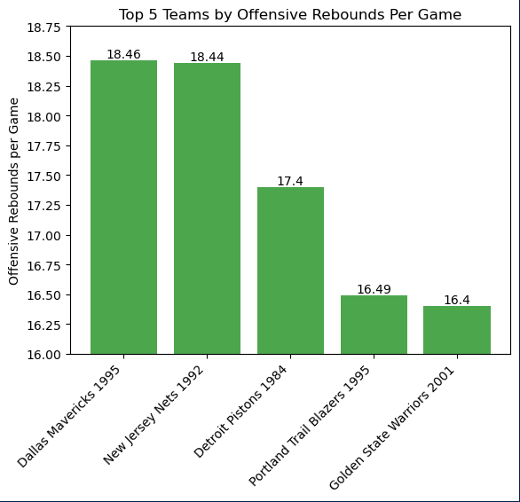
OFFENSIVE RATING ASSISTS PER GAME
OFFENSIVE STATS
POINTS PER GAME REBOUNDS PER GAME

Slide 7
Limitations & Next Steps
Seasonal Comparison: Tracking how teams perform over time by comparing offense and defense across seasons.
Playoff Impact: Understanding how offensive and defensive stats relate to playoff success tells us what really matters in the postseason.
Player Contributions: Diving into individual player(s) stats to see who's driving the team's success.
Expanded Metrics: Looking beyond the basics, adding stats like turnovers to give a deeper understanding of what drives performance.
Rule Changes Analysis: Examine how rule changes throughout the years affect team performances.

Slide 8

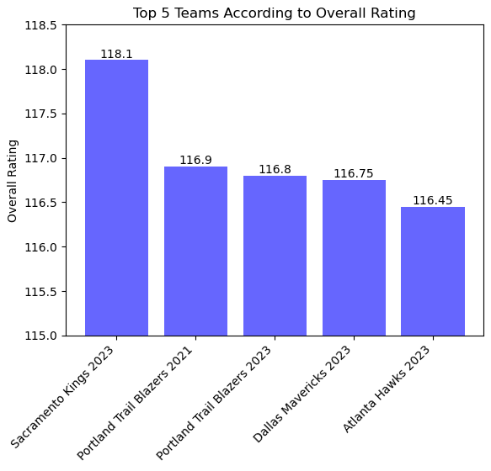
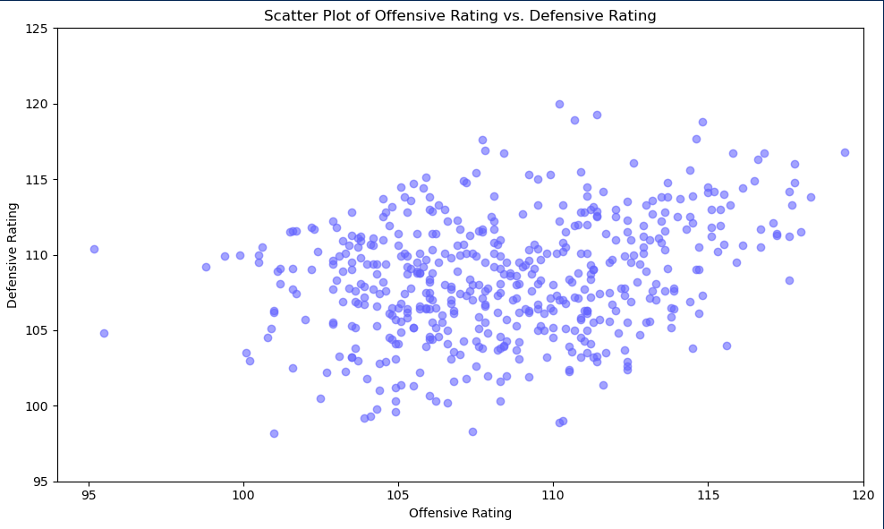
Troubleshoot/Challenges
After formatting all the stats & putting them into columns, data was not being organized in descending order
The reason this was happening was because the data that was being read in as a string
Changing the data to a float after formatting fixed the error
Coming up with visualizations beyond bar graphs

Slide 9
conclusion

Slide 10
CITATIONS
https://www.kaggle.com/datasets/sumitrodatta/nba-aba-baa-stats
https://www.basketball-reference.com
https://stackoverflow.com/questions/7908636/how-to-add-hovering-annotations-to-a-plot
https://www.nba.com/stats
https://matplotlib.org/stable/api/_as_gen/matplotlib.pyplot.annotate.html

